Slide 1


Role of Safety Committee Members in
EHS activities / Work Permit
Sunil Katekari
Head – Environment Health & Safety
VVF ( India) Limited

Slide 2
Work Permit System
While performing certain types of job under certain conditions serious accidents / incidents may result.
Work Permit System is a method for ensuring controls over hazardous operation performed in unfavorable condition.
Generally work permit required for non-routine jobs

Slide 3
Why Work Permit?
Materials - poses special risks.
Maintenance personnel are not adequately familiar with process conditions.
Assurance by Operations that designated job is safe to perform.
Basic purpose of permit system is to prevent injuries to personnel, Protect property from damage, prevent fire & other emergencies.
Ensure that all work is carried out in safest possible manner.
Permit specifies the conditions and procedure for safe execution.

Slide 4
What is Work Permit?
It is a document which categorically spells out –
  Task.
  Equipment Involved.
  Its Location.
  Personnel Involved.
  Time Limits.
  Precautionary measures.
  Likely hazards to be encountered.

Slide 5
Jobs Required Permit
Welding & cutting
Grinding
Open fires/flames
Drilling
Chipping
Soldering
Sand blasting
Other non routine jobs- opening of lines, equipments containing hazardous liquid, vapour, fumes etc
Civil work, painting, insulation
Work at height
Excavation

Slide 6
Importance of Permit
It is a method which helps to meet various conditions required for making hazardous operation safe and easy to perform
Provides written information on prevalent hazards.
Spells remedial measures.
Serves as a Check List for various safety precaution is to be taken
Media of information to all concerned.
Written record of operation / personnel involved in authorizing and carrying out the job.

Slide 7

Create Awareness
To conduct tool box talk.
Participate in Risk Assessment.
Ensure use of essential PPE’s at work.
Motivate employees in participate in EHS promotional activities .
To conduct Table top mock drill exercise.

Slide 8


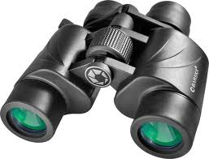
Monitoring
Work permit
Activities around you.
Unsafe Actions/ Unsafe conditions.
Emergency equipment's around you.

Slide 9

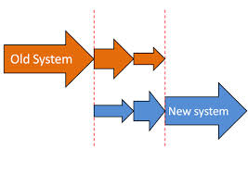
Implementation
New systems , procedures , policies adopted by Management

Slide 10

Reporting
By reporting unsafe things you can save life & property

Slide 11
Representation
Represent departmental EHS activities.
Ensure elimination of unsafe actions / unsafe conditions.

Slide 12
Safety committee members are
equally responsible & they are empowered to stop any unsafe work.
reporting unsafe actions / unsafe conditions as well as taking responsibility for rectification of these points.
playing important role in emergency preparedness.
conducting tool box talk to company as well as contract worker on topic given by EHS dept.
demanding for Safety of employees as well as property.
motivating the other employees to take active part in EHS activities.
highlighting & sharing positive points implemented within department.

